Slide 1
14 C++ Features in 40 Minutes
Billy O’Neal, Visual C++ Libraries
bion@Microsoft.com
@MalwareMinigun
Notes:
35 minutes, code in 28 font

Slide 2
In this talk – C++17 features unless noted
Core features:
Feature test macros (C++20)
Expression evaluation order
Structured Bindings
Initializers in Selection Statements
Class Template Argument Deduction (CTAD)
[[nodiscard]]
Library Features
string_view
optional
variant
Variadic lock_guard
Parallel Algorithms
Associative contains (C++20)
Splicing Maps and Sets
Unordered transparency (C++20)

Slide 3
Core Features

Slide 4
Feature Test Macros (C++20)
Test if the compiler or standard library implements a given feature for the current build mode
Core features: http://eel.is/c++draft/cpp.predefined
Library features: http://eel.is/c++draft/support.limits.general
Examples of proper use from http://eel.is/c++draft/cpp.cond

Slide 5
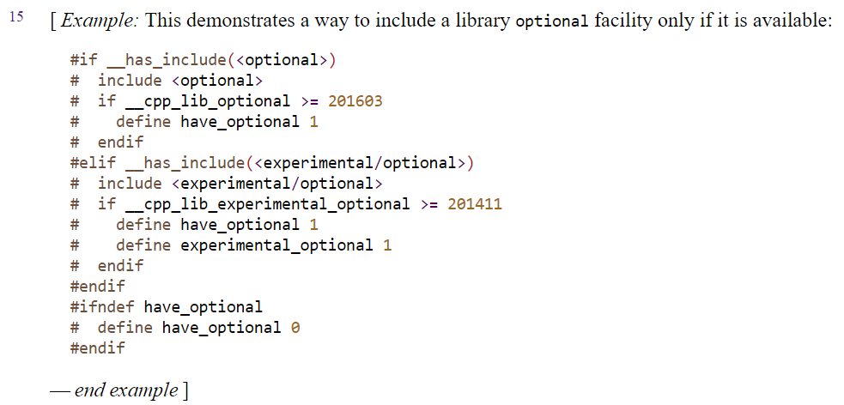
Feature Test Macros (C++20)

Slide 6
Expression Evaluation Order
For the most part, just does what you expect. Folks are surprised this didn’t work before!
Examples here are from the original paper: http://www.open-std.org/jtc1/sc22/wg21/docs/papers/2016/p0145r3.pdf

Slide 7
Expression Evaluation Order
#include <map>
int main() {
std::map<int, int> m;
m[0] = m.size();
}

Slide 8
Expression Evaluation Order
#include <assert.h>
#include <string>
void f()
{
std::string s = "but I have heard it works even if you don’t believe in it";
s.replace(0, 4, "").replace(s.find("even"), 4, "only").replace(s.find(" don’t"), 6, "");
assert(s == "I have heard it works only if you believe in it");
}

Slide 9
Structured Bindings
Easy access to all the members of a tuple-like type
Tuple-like types include:
Plain structs
std::array
std::tuple
std::pair

Slide 10
Structured Bindings
Type of unnamed tuple-like object
Names of aliases for “members”
Any initializing expression
auto [a, b, c] = ex;

Slide 11
Structured Bindings
#include <ntdef.h>
#include <windows.h>
UNICODE_STRING get_str();
int main() {
auto [Length, MaxLength, Buffer] = get_str();
DWORD charsWritten;
if (!WriteConsoleW(GetStdHandle(STD_OUTPUT_HANDLE),
Buffer, Length, &charsWritten, nullptr)
|| charsWritten != Length) {
// Writing that failed for some reason
}
}

Slide 12
Structured Bindings
#include <stdio.h>
struct example {
int a;
int b;
int c;
};
void print_example(const example& ex) {
printf("a: %d b: %d c: %d",
ex.a, ex.b, ex.c);
}

Slide 13
Structured Bindings
int main() {
example ex; auto& [d, e, f] = ex;
d = 42;
e = 1234;
f = 1729;
print_example(ex);
}
int main() {
example ex;
ex.a = 42;
ex.b = 1234;
ex.c = 1729;
print_example(ex);
}

Slide 14
Structured Bindings
// make a vector of 1000 random unsigned integers:
std::random_device rd;
std::vector<unsigned> examples(1000);
std::generate(examples.begin(), examples.end(),
std::ref(rd));
// print the lowest and highest values:
auto [lowest, highest] =
std::minmax_element(examples.begin(), examples.end());
printf("Low: %u High: %u\n", *lowest, *highest);

Slide 15
Structured Bindings
// make a vector of 1000 random unsigned integers:
std::random_device rd;
std::vector<unsigned> examples(1000);
std::generate(examples.begin(), examples.end(),
std::ref(rd));
// print the lowest and highest values:
auto [lowest, highest] =
std::minmax_element(examples.begin(), examples.end());
printf("Low: %u High: %u\n", *lowest, *highest);
std::pair<std::vector<unsigned>::iterator, std::vector<unsigned>::iterator>, where .first is lowest, and .second is highest

Slide 16
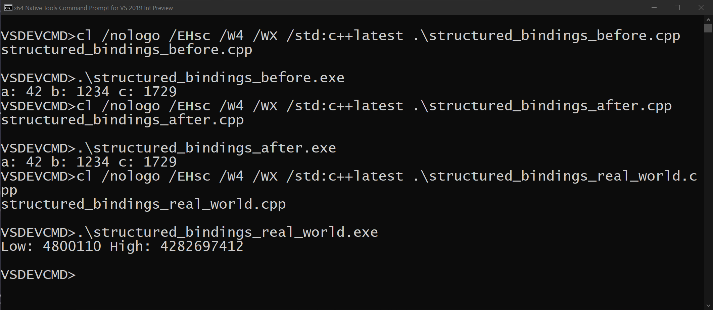
Structured Bindings

Slide 17
Selection Statements with Initializers
Like for (initializer; while-true; increment), but for all control flow statements like if.
For example: if (initializer; condition)

Slide 18
Selection Statements with Initializers
a();
if (int var = get_val(); var < 42) {
printf("%d", var);
}
b();

Slide 19
Selection Statements with Initializers
a();
{
int var = get_val();
if (var < 42) {
printf("%d", var);
}
// var doesn't 'escape' into the enclosing scope
}
b();

Slide 20
Selection Statements with Initializers
// example from the compiler
if (const auto symbol = thisArg->Symbol(); symbol->Kind()
== SY_FORMALPARAMETER)
varToDestroy = FindVar(symbol);

Slide 21
Selection Statements with Initializers
std::unique_ptr<int> get_value() {
constexpr auto maxInt = static_cast<unsigned>(INT_MAX);
const unsigned val = std::random_device{}();
if (val > maxInt) { return {}; }
return std::make_unique<int>(static_cast<int>(val));
}

Slide 22
Selection Statements with Initializers
for (int i = 0; i < 10; ++i) {
if (std::unique_ptr<int> p = get_value(); p.get()) {
printf("The value was %i\n", *p);
} else {
puts("The value was null");
}
}

Slide 23
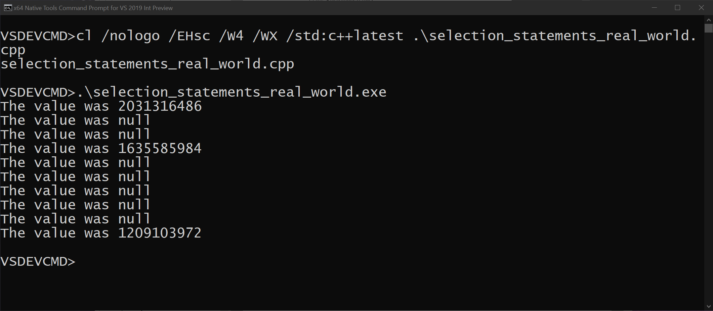
Selection Statements with Initializers

Slide 24
Together now!
if (auto [success, temporary] =
ExpressionContainsATemporary(skippedExtractTree); success)
{
// Replace the temporary with our target
// ...
}
else
{
return PerformCallConstructor(target);
}

Slide 25
Together now!
if (auto [success, temporary] =
ExpressionContainsATemporary(skippedExtractTree); success)
{
// Replace the temporary with our target
// ...
}
else
{
return PerformCallConstructor(target);
}
Structured Bindings!
Initializer!

Slide 26
Class template argument deduction
C++14 and earlier can only do template argument deduction for functions, for example max(1, 2) calls max<int>.

Slide 27
Class template argument deduction
template<typename T>
T max(T a, T b) {
return a < b ? b : a;
}
max(1, 2); // calls max<int>(int, int); int deduced

Slide 28
Class template argument deduction
Factory functions are the standard workaround (e.g. std::make_pair), but have both cognitive and performance overheads.

Slide 29
Class template argument deduction
template<class First, class Second>
struct pair {
First first;
Second second;
pair(First first_, Second second_)
: first(first_)
, second(second_)
{ }
};

Slide 30
Class template argument deduction
// Workaround for C++14:
template<class First, class Second>
pair<First, Second> make_pair(const First& f, const Second& s) {
// maybe extra temporaries for params
return {f, s}; // extra copy of result
}
int main() {
SomeReallyLongStructNameItGoesOnForeverHelp x;
// C++14
auto p = make_pair(x, x); // use function template to get deduction
}

Slide 31
Class template argument deduction
// No longer needed in C++17:
// template<class First, class Second>
// pair<First, Second> make_pair(const First& f, const Second& s);
int main() {
SomeReallyLongStructNameItGoesOnForeverHelp x;
pair p{x, x}; // class template can deduce by itself
}
No <>s!

Slide 32
Class template argument deduction
template<class First, class Second>
struct pair {
First first;
Second second;
pair(First first_, Second second_)
: first(first_)
, second(second_)
{ }
};

Slide 33
Also works with the standard library
std::vector x = {1, 2, 3, 4}; // std::vector<int>
std::array a = {1, 2, 3, 4}; // std::array<int, 4>
using namespace std::literals;
std::vector v = {L"abc"s, L"def"s, L"hij"s};
// std::vector<std::wstring>

Slide 34
Class template argument deduction
Stephan T. Lavavej gave a talk with more CTAD edge cases at CppCon, available at https://www.youtube.com/watch?v=-H-ut6j1BYU
Some factory functions still have uses; don’t assume make_xxx is always for type deduction. A standard library example is make_shared<T>, for stapling the reference count control block to a given T.

Slide 35
[[nodiscard]]
Morally equivalent to our _Check_return_, but works with all compilers and/or with preFAST / OACR disabled.

Slide 36
[[nodiscard]]
This example from actual Windows code, provided by Dmitry Vasilevsky
if (nullptr != sampleData)
{
m_sampleData = sampleData;
m_validSampleIndices = GetValidIndices(m_sampleData);
}
else
{
m_sampleData = nullptr;
m_validSampleIndices.empty();
}
Notes:
Let me give you one specific example from windows codebase right away.
Let's play a little game. Here's round 1. Who can spot a problem in this code?
Don't asnwer or raise your hand, just think of an answer.
Yes, you are right, the standard library function that checks emptiness
is mistaken for the for the function that clears vector. But there was nothing to catch this error.
Now function empty() is marked with nodiscard. [?? ref says c++20]
So compiler reports an error when its result is discarded.

Slide 37
[[nodiscard]]
if (nullptr != sampleData)
{
m_sampleData = sampleData;
m_validSampleIndices = GetValidIndices(m_sampleData);
}
else
{
m_sampleData = nullptr;
m_validSampleIndices.empty();
}
.clear() intended
Notes:
Let me give you one specific example from windows codebase right away.
Let's play a little game. Here's round 1. Who can spot a problem in this code?
Don't asnwer or raise your hand, just think of an answer.
Yes, you are right, the standard library function that checks emptiness
is mistaken for the for the function that clears vector. But there was nothing to catch this error.
Now function empty() is marked with nodiscard. [?? ref says c++20]
So compiler reports an error when its result is discarded.

Slide 38
[[nodiscard]]
struct MyClass {
[[nodiscard]] bool operator==(const MyClass&) const {
return true;
}
};
MyClass a;
a == a;
(void)(a == a); // suppress compilation error
Get compilation warning here!
Notes:
If you’re adding your own functions that are likely to be confused this way, you apply the [[nodiscard]] attribute, as shown on empty on line 8 here. [[ ]] is C++’s “attribute” syntax, sort of a portable version of __declspec.

Slide 39
Library Features

Slide 40
string_view
Duct tape of string types – just a pointer and a size. Avoids strlen.
Used to erase the string type in use on interfaces that only need read-only access.
Implicitly convertible from character literals, or use sv user defined literal.
Implicitly convertible from std::strings.
Implicitly convertible from winrt::hstring.
Does not extend the lifetime of the string data – be careful to avoid use-after-free.

Slide 41
string_view
void f(wstring_view); // string_view that uses wchar_t’s
// pass a std::wstring:
std::wstring& s; f(s);
// pass a C-style null-terminated string (string_view is not null-terminated):
wchar_t* ns = ""; f(ns);
// pass a C-style character array of len characters (excluding null terminator):
wchar_t* cs, size_t len; f({cs,len});
// pass a WinRT string
winrt::hstring hs; f(hs);

Slide 42
Optional values without memory allocation: std::optional
std::optional<int> models int*, except the memory for the int is inside the optional itself.

Slide 43
std::optional
#include <optional>
struct UserSettings {
std::optional<int> indentWidth;
};
void LoadUserSettings(UserSettings&) {
// load the settings from a file or similar
}
UserSettings settings;
LoadUserSettings(settings);
if (settings.indentWidth) {} // convert to bool to test if the optional is engaged
settings.indentWidth.has_value(); // alternately, call has_value
*settings.indentWidth; // get the value, dereference like a pointer
settings.indentWidth.value_or(4); // value_or gets value, or supplied default

Slide 44
Increasing safety of unions: std::variant
Tagged / discriminated union which keeps track of which union member is active.
Multiples of the same type are allowed: variant<int, int, int>.
Supports visitation scenarios, useful in cases like collision modeling.

Slide 45
Increasing the safety of unions: std::variant
struct JsonArray {};
struct JsonObject {};
struct JsonNumber {};
std::variant<JsonArray, JsonObject, JsonNumber>
parse_json(const char*);
// expected the user to say "42", but said "{42}":
auto v = parse_json("{42}");
v.index(); // gets the active variant member index
std::get<JsonNumber>(v); // throws bad_variant_access
std::get<JsonObject>(v); // returns reference to the JsonObject
std::get<0>(v); // also bad_variant_access
std::get<1>(v); // ok
// destructor of the active variant member called automatically

Slide 46
Increasing the safety of unions: std::variant
std::variant<JsonArray, JsonObject, JsonNumber>
parse_json(const char* c) {
if (c[0] == '{') {
// parse
return JsonObject{};
} else if (c[0] == '[') {
// parse
return JsonArray{};
}
// parse
return JsonNumber{};
}

Slide 47
Increasing the safety of unions: std::variant
Conversions are handled for you
std::variant<std::string, double> g() {
return "hello world";
}

Slide 48
Increasing safety of unions: std::variant
#include <stdio.h>
#include <string>
#include <variant>
struct Success {};
struct Failure {
std::string message;
};
std::variant<Success, Failure> do_thing() {
if (2 + 2 == 5) { // for large values of 2?
return Failure{"Math is broken"};
}
return Success{};
}

Slide 49
Increasing safety of unions: std::variant
int main() {
auto result = do_thing();
switch(result.index()) {
case 0: // active member is Success
puts("Success");
break;
case 1:
puts("Failure:");
puts(std::get<Failure>(result).message.c_str());
// variant took care of destroying the string inside
break;
}
}

Slide 50
Behavior for each type: std::visit
struct Visitor {
void operator()(const Success&) const {
puts("Success");
}
void operator()(const Failure& f) const {
puts("Failure");
puts(f.message.c_str());
}
};
std::visit(Visitor{}, do_thing());

Slide 51
std::visit passing through return types
#include <Windows.h>
struct HResultVisitor {
HRESULT operator()([[maybe_unused]] const Success& s) const {
return S_OK;
}
HRESULT operator()([[maybe_unused]] const Failure& f) const {
return E_FAIL;
}
};
extern "C" HRESULT __stdcall some_c_api_wrapper() noexcept {
return std::visit(HResultVisitor{}, do_thing());
}

Slide 52
Multiple variants: collision modeling
#include <stdio.h>
#include <variant>
struct LeftClick {};
struct RightClick {};
using ClickType = std::variant<LeftClick, RightClick>;
struct Button {};
struct Widget {};
struct TextBox {};
using TargetType = std::variant<Button, Widget, TextBox>;
void HandleCollision(const ClickType& click, const TargetType& target);

Slide 53
void HandleCollision(const ClickType& click,
const TargetType& target) {
struct Visitor {
void operator()(LeftClick, Button) const {
puts("Button was left clicked");
}
void operator()(LeftClick, Widget) const {
puts("Widget was left clicked");
}
void operator()(LeftClick, TextBox) const {
puts("TextBox was left clicked");
}
void operator()(RightClick, Button) const {
puts("Button was right clicked");
}
void operator()(RightClick, Widget) const {
puts("Widget was right clicked");
}
void operator()(RightClick, TextBox) const {
puts("TextBox was right clicked");
}
};
std::visit(Visitor{}, click, target);
}

Slide 54
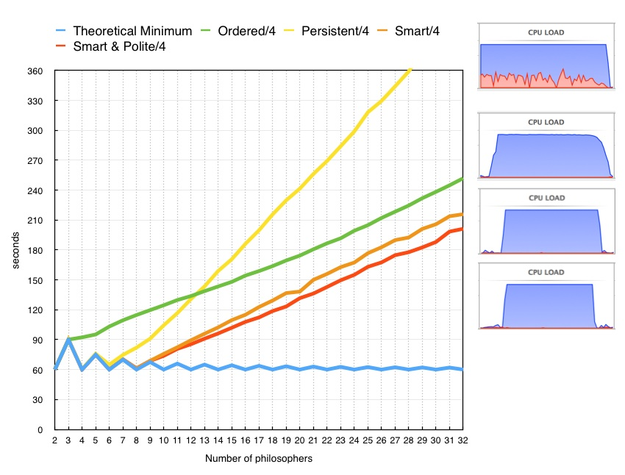
Variadic lock_guard: scoped_lock
Takes multiple locks using a deadlock avoidance algorithm
Oblivious to mutex type, scheduler, etc.
More efficient than defining a lock ordering, see http://howardhinnant.github.io/dining_philosophers.html
template<class... MutexTypes>
class scoped_lock;

Slide 55
scoped_lock
struct DataValue {
mutable std::shared_mutex m;
int theValue;
};
void modify_both(DataValue& a, DataValue& b) {
// class template argument deduction!
std::scoped_lock lock(a.m, b.m); // takes both
// mutexes without deadlock
std::swap(a.theValue, b.theValue);
// both mutexes are unlocked upon exiting the scope
}

Slide 56
Parallel Algorithms
std::sort(a, b, pred) =>
std::sort(std::execution::par, a, b, pred)
See blog post for more nitty gritty:
https://devblogs.microsoft.com/cppblog/using-c17-parallel-algorithms-for-better-performance/

Slide 57
Parallel Algorithms
template<class T>
void parallel_sort(benchmark::State& state) {
const size_t r0 = static_cast<size_t>(state.range(0));
for (auto _ : state) {
state.PauseTiming();
vector<T> data(r0);
fill_with_random(data);
state.ResumeTiming();
sort(execution::par, data.begin(), data.end(), less<>{});
}
}

Slide 58
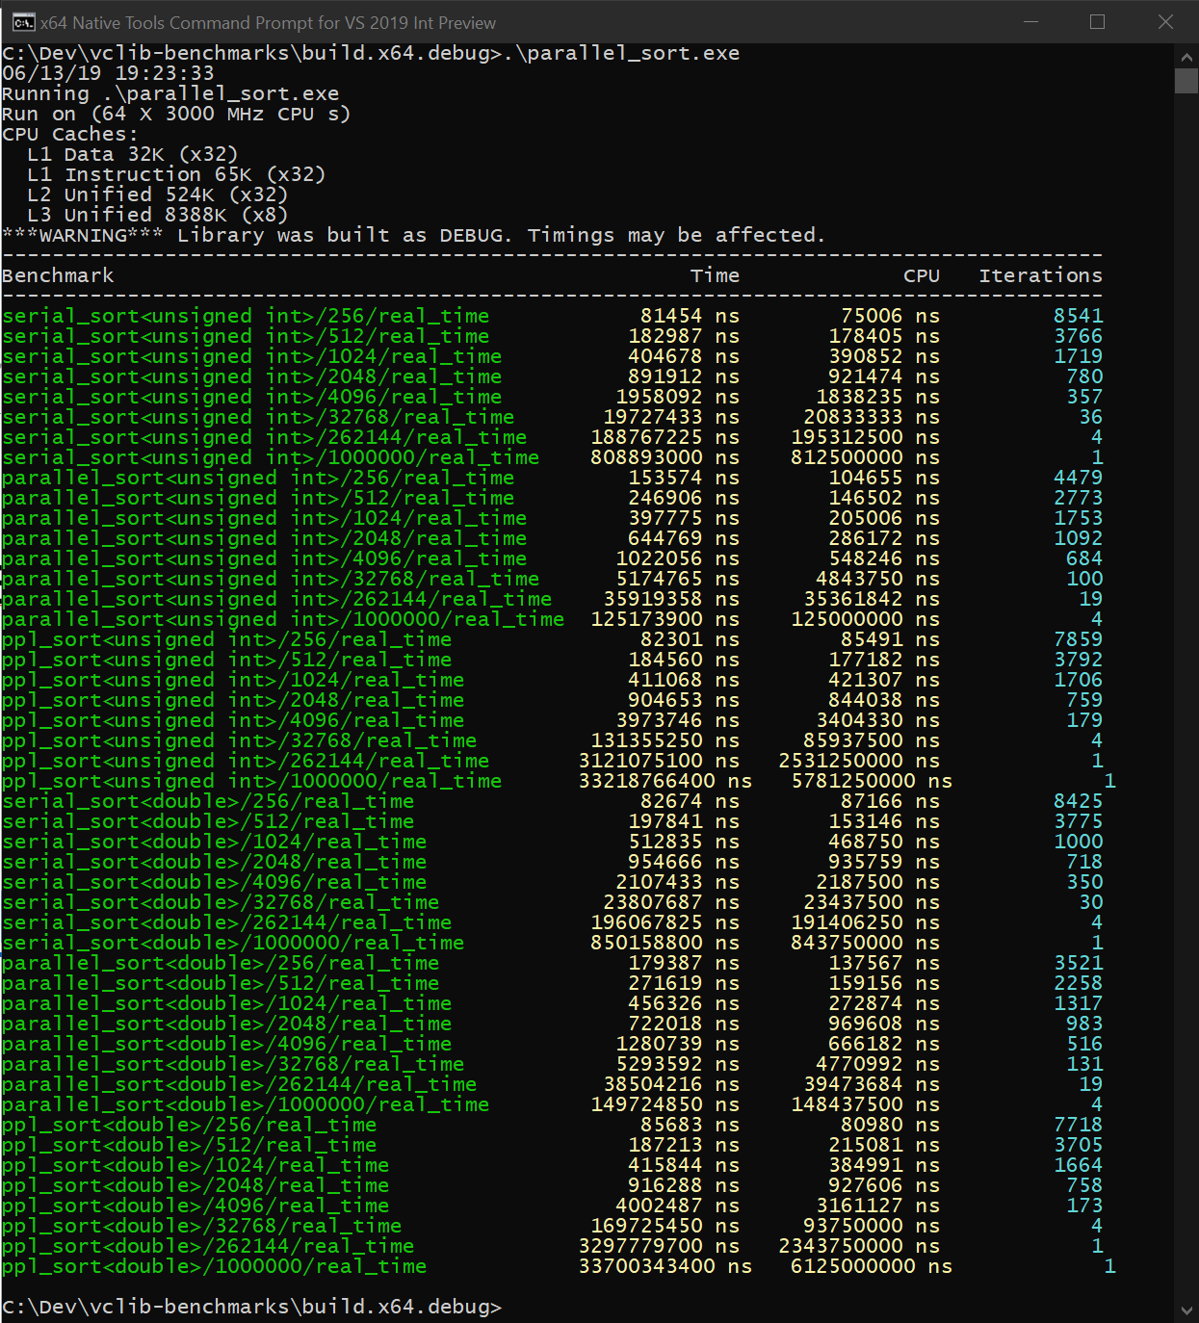
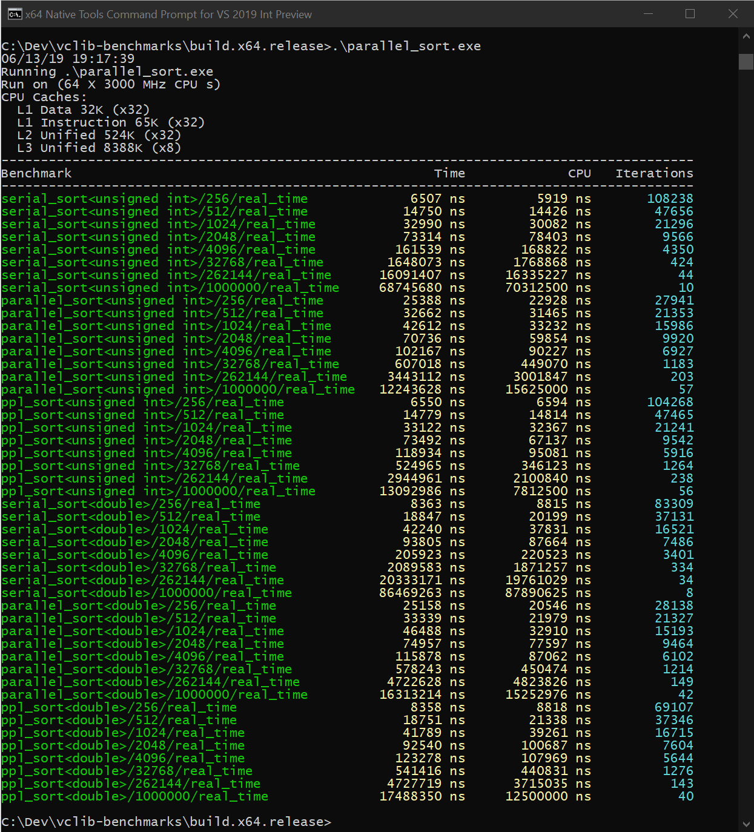
Parallel Algorithms

Slide 59
Parallel Algorithms
Debug
element count | 256 | 512 | 1024 | 2048 | 4096 | 32768 | 262144 | 1000000
serial, unsigned int | 81454 | 182987 | 404768 | 891912 | 1958092 | 19727433 | 188767225 | 808893000
parallel, unsigned int | 153574 | 246906 | 397775 | 644769 | 1022056 | 5174765 | 35919358 | 125173900
Relative Time | 1.885407715 | 1.349308967 | 0.982723437 | 0.72290652 | 0.52196526 | 0.262313145 | 0.190283869 | 0.154747167
Win, Times | 0.530389259 | 0.741120102 | 1.01758029 | 1.383304718 | 1.915836314 | 3.812237464 | 5.255306206 | 6.462153852
ppl, unsigned int | 82301 | 184560 | 411068 | 904653 | 3873746 | 131355250 | 3121075100 | 33218766400
Relative Time | 1.010398507 | 1.008596239 | 1.015564471 | 1.014285042 | 1.978326861 | 6.658506963 | 16.53398836 | 41.06694754
Win, Times | 0.989708509 | 0.991477026 | 0.984674069 | 0.985916147 | 0.505477644 | 0.150183818 | 0.060481475 | 0.024350483

Slide 60
Parallel Algorithms
Debug
element count | 256 | 512 | 1024 | 2048 | 4096 | 32768 | 262144 | 1000000
serial, unsigned int | 81454 | 182987 | 404768 | 891912 | 1958092 | 19727433 | 188767225 | 808893000
parallel, unsigned int | 153574 | 246906 | 397775 | 644769 | 1022056 | 5174765 | 35919358 | 125173900
Relative Time | 1.885407715 | 1.349308967 | 0.982723437 | 0.72290652 | 0.52196526 | 0.262313145 | 0.190283869 | 0.154747167
Win, Times | 0.530389259 | 0.741120102 | 1.01758029 | 1.383304718 | 1.915836314 | 3.812237464 | 5.255306206 | 6.462153852
ppl, unsigned int | 82301 | 184560 | 411068 | 904653 | 3873746 | 131355250 | 3121075100 | 33218766400
Relative Time | 1.010398507 | 1.008596239 | 1.015564471 | 1.014285042 | 1.978326861 | 6.658506963 | 16.53398836 | 41.06694754
Win, Times | 0.989708509 | 0.991477026 | 0.984674069 | 0.985916147 | 0.505477644 | 0.150183818 | 0.060481475 | 0.024350483

Slide 61
Parallel Algorithms
Debug
element count | 256 | 512 | 1024 | 2048 | 4096 | 32768 | 262144 | 1000000
serial, unsigned int | 81454 | 182987 | 404768 | 891912 | 1958092 | 19727433 | 188767225 | 808893000
parallel, unsigned int | 153574 | 246906 | 397775 | 644769 | 1022056 | 5174765 | 35919358 | 125173900
Relative Time | 1.885407715 | 1.349308967 | 0.982723437 | 0.72290652 | 0.52196526 | 0.262313145 | 0.190283869 | 0.154747167
Win, Times | 0.530389259 | 0.741120102 | 1.01758029 | 1.383304718 | 1.915836314 | 3.812237464 | 5.255306206 | 6.462153852
ppl, unsigned int | 82301 | 184560 | 411068 | 904653 | 3873746 | 131355250 | 3121075100 | 33218766400
Relative Time | 1.010398507 | 1.008596239 | 1.015564471 | 1.014285042 | 1.978326861 | 6.658506963 | 16.53398836 | 41.06694754
Win, Times | 0.989708509 | 0.991477026 | 0.984674069 | 0.985916147 | 0.505477644 | 0.150183818 | 0.060481475 | 0.024350483

Slide 62
Parallel Algorithms
Release
element count | 256 | 512 | 1024 | 2048 | 4096 | 32768 | 262144 | 1000000
serial, unsigned int | 6507 | 14750 | 32990 | 73314 | 161539 | 1648073 | 16091407 | 68745680
parallel, unsigned int | 25388 | 32662 | 46212 | 70736 | 102167 | 607018 | 3443112 | 12243628
Relative Time | 3.901644383 | 2.214372881 | 1.400788118 | 0.964836184 | 0.632460273 | 0.36832 | 0.213972091 | 0.178100326
Win, Times | 0.25630219 | 0.451595126 | 0.71388384 | 1.036445374 | 1.581126978 | 2.715032 | 4.6735067 | 5.614812864
ppl, unsigned int | 6550 | 14779 | 33122 | 73492 | 118934 | 524965 | 2944961 | 13092986
 | 1.006608268 | 1.001966102 | 1.004001212 | 1.002427913 | 0.736255641 | 0.318533 | 0.183014512 | 0.1904554
 | 0.993435115 | 0.998037756 | 0.996014733 | 0.997577968 | 1.358223889 | 3.139396 | 5.464047571 | 5.250573093

Slide 63
Parallel Algorithms
Release
element count | 256 | 512 | 1024 | 2048 | 4096 | 32768 | 262144 | 1000000
serial, unsigned int | 6507 | 14750 | 32990 | 73314 | 161539 | 1648073 | 16091407 | 68745680
parallel, unsigned int | 25388 | 32662 | 46212 | 70736 | 102167 | 607018 | 3443112 | 12243628
Relative Time | 3.901644383 | 2.214372881 | 1.400788118 | 0.964836184 | 0.632460273 | 0.36832 | 0.213972091 | 0.178100326
Win, Times | 0.25630219 | 0.451595126 | 0.71388384 | 1.036445374 | 1.581126978 | 2.715032 | 4.6735067 | 5.614812864
ppl, unsigned int | 6550 | 14779 | 33122 | 73492 | 118934 | 524965 | 2944961 | 13092986
 | 1.006608268 | 1.001966102 | 1.004001212 | 1.002427913 | 0.736255641 | 0.318533 | 0.183014512 | 0.1904554
 | 0.993435115 | 0.998037756 | 0.996014733 | 0.997577968 | 1.358223889 | 3.139396 | 5.464047571 | 5.250573093

Slide 64
Contains (C++20)
New member of maps and sets that does just what it says – bool to ask if an element is in the container
Alternative to find() != end() or count() != 0

Slide 65
Contains (C++20)
printf("find != end 24: %s\n",
s.find(24) != s.end() ? "true" : "false");
printf("find != end 67: %s\n",
s.find(67) != s.end() ? "true" : "false");
printf("count 24: %s\n", s.count(24) != 0 ? "true" : "false");
printf("count 67: %s\n", s.count(67) != 0 ? "true" : "false");
printf("contains 24: %s\n", s.contains(24) ? "true" : "false");
printf("contains 67: %s\n", s.contains(67) ? "true" : "false");

Slide 66
Splicing Maps and Sets
Extract elements from maps or sets, and mutate them or reinsert them later
Combine maps and sets into each other with the merge member
No allocations

Slide 67
Splicing Maps and Sets
using UnwindMapData =
UtcPool::map<T_ALLOC, EHSTATE, UWentry>;
for (auto &UWEntry : funcInfo.UnwindMap)
{
// Change entry to be keyed off new state
auto movedEntry =
funcInfo.UnwindMap.extract(UWEntry.first);
movedEntry.key() = newState;
funcInfo.UnwindMap.insert(move(movedEntry));
}

Slide 68
Splicing Maps and Sets
std::set set1 = {1, 2, 4, 1000, 1234, -67, 1729};
std::set set2 = {-1, 2, 4, -1000, 1234, 7, -1729};
print_ints("set1", set1);
print_ints("set2", set2);
set1.merge(set2);
print_ints("set1, after merge", set1);
print_ints("set2, after merge", set2);

Slide 69
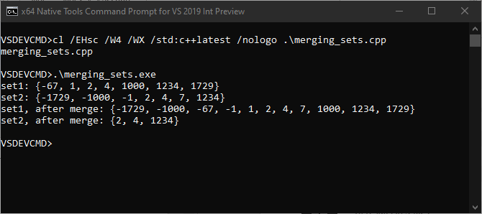
Splicing Maps and Sets

Slide 70
Unordered Transparency
void example(std::set<std::string>& s) {
s.find("hello world"); // implicitly allocates memory :(
s.find("hello world"sv); // doesn't compile X(
s.find(std::string("hello world"sv)); // allocates memory :(
}
void example(std::set<std::string, std::less<>>& s) {
s.find("hello world"); // doesn't allocate memory but strlen :/
s.find("hello world"sv); // doesn't allocate memory :D
}

Slide 71
Unordered Transparency
Like C++14 transparent ordered associative containers extended to unordered containers
Then: std::map<std::string, int, std::less<>>
Now: std::unordered_map<std::string, int, ASpecialHash>

Slide 72
Unordered Transparency
struct hasher {
// equal_to has is_transparent
using transparent_key_equal = std::equal_to<>;
std::size_t operator()(std::string_view sv) {
return std::hash<std::string_view>{}(sv);
}
};
void example(std::unordered_set<std::string, hasher>& s) {
s.find("hello world"); // doesn't allocate memory but strlen :/
s.find("hello world"sv); // doesn't allocate memory :D
}

Slide 73
Thanks all!
Talk materials at https://github.com/BillyONeal/14_cpp_features_in_40_minutes

